Slide 1
Regression Relationships
Nouman M Durrani

Slide 2
Introduction
Regression analysis is the most widely used method for the analysis of dependence
that is, for examining the relationship between a set of independent variables (X's) and a single dependent variable (Y).
Regression (in general) is a linear combination of independent variables that corresponds as closely as possible to the dependent variable.
Y=b₀+b₁x₁+b₂x₂ + …+b_{n}x_{n}

Slide 3
Regression versus Classification
Classification: the output variable takes class labels
Regression: the output variable takes continuous values

Slide 4
Examples
Predicting House Value
Actual Price: £100,000
Predicted 1: £99,950 (Very Good Prediction)
Predicted 1: £50,000 (Very Bad Prediction)
Predicting Car Premium
Using Location, Age, History etc

Slide 5
Regression Techniques
Linear Regression
Ridge Regression
Logistic Regression
Lasso Regression
And many more

Slide 6
Linear Equations
© 1984-1994 T/Maker Co.
Notes:
28

Slide 7
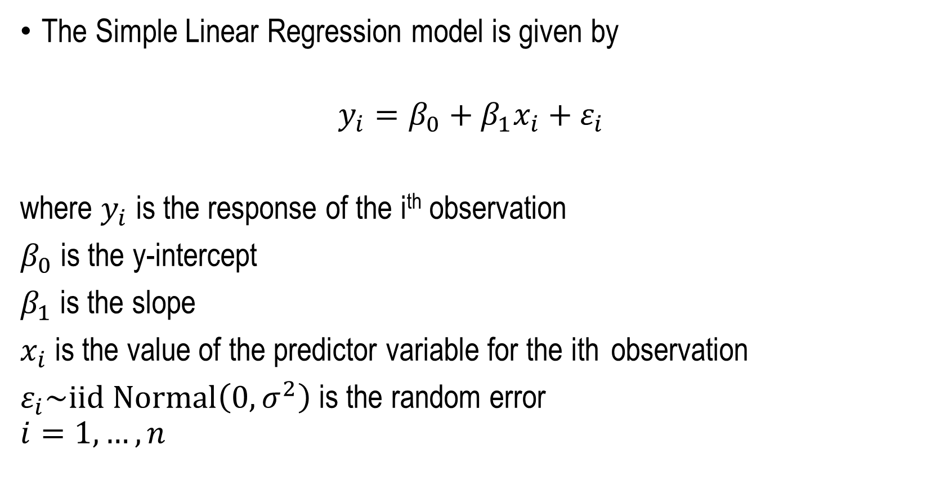
Simple Linear Regression
The Simple Linear Regression model is given by
$$y_{i}=β_{0}+β_{1}x_{i}+ε_{i}$$
where $y_{i}$ is the response of the i^{th} observation
$β_{0}$ is the y-intercept
$β_{1}$ is the slope
$x_{i}$ is the value of the predictor variable for the ith observation
$ε_{i}\sim iid Normal\left(0,σ^{2}\right)$ is the random error
$$i=1,…,n$$

Slide 8
Linear Regression Model
1. Relationship Between Variables Is a Linear Function
Population Y-Intercept
Population Slope
Random Error
Y
=
β
+
β
X
+
ε
i
0
1
i
i
Dependent (Response) Variable (e.g., CD+ c.)
Independent (Explanatory) Variable (e.g., Years s. serocon.)

Slide 9
Population Linear Regression Model
Try to find a line that will fit all my points, based on the Least square method
Observedvalue
ε_{i} = Random error
Observed value
Notes:
35

Slide 10
Simple Linear Regression
Simple Linear Regression (SLR) is used to model the relationship between two continuous variables.
Scatterplots are used to graphically examine the relationship between two quantitative variables.
The variable on the x-axis is often called the explanatory or predictor variable.
The variable on the y-axis is called the response variable.
Sullivan (pg. 193)

Slide 11
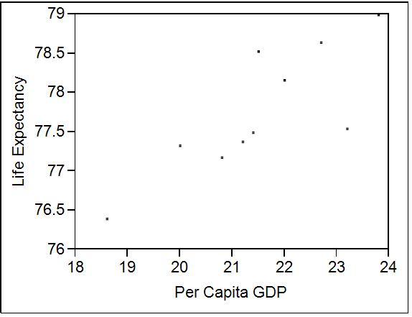
Simple Linear Regression
Can we describe the
behavior between
the two variables
with a linear equation?
The variable on the x-axis is often called the explanatory or predictor variable.
The variable on the y-axis is called the response variable.

Slide 12
Simple Linear Regression
Objectives of Simple Linear Regression
Determine the significance of the predictor variable in explaining variability in the response variable.
(i.e. Is per capita GDP useful in explaining the variability in life expectancy?)
Predict values of the response variable for given values of the explanatory variable.
(i.e. if we know the per capita GDP can we predict life expectancy?)
Note: The predictor variable does not necessarily cause the response.
Notes:
Try to find a line that will fit all my points, based on the Least square method

Slide 13
Regression Model Purposes
Regression models are used for purposes of description, inference and prediction.
1. Description:
How can we describe the relationship between the dependent variable and the independent variables?
How strong is the relationship captured by the model?
2. Inference:
Is the relationship described by the model statistically significant (i.e., is this level of association between the fitted values and the actual values likely to be the result of chance alone?)
Which independent variables are most important?
3. Prediction:
How well does the model generalize the observations outside the sample?
Notes:
That you can be sure that there is less than a 5% chance that the strength of the relationship you found (your ρ coefficient) happened by chance if the null hypothesis were true.

Slide 14
Simple Linear Regression Equation
Positive Linear Relationship
E(y)
Regression line
Intercept
β₀
Slope β₁
is positive
x

Slide 15
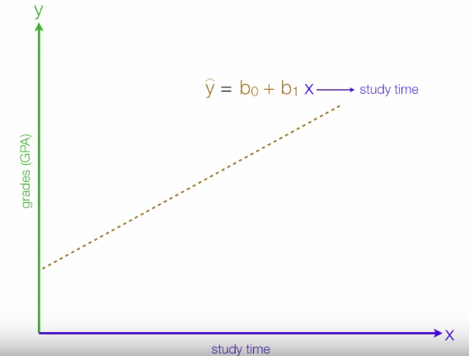
Positive Linear Relationship

Slide 16
Simple Linear Regression Equation
Negative Linear Relationship
E(y)
Intercept
β₀
Regression line
Slope β₁
is negative
x

Slide 17
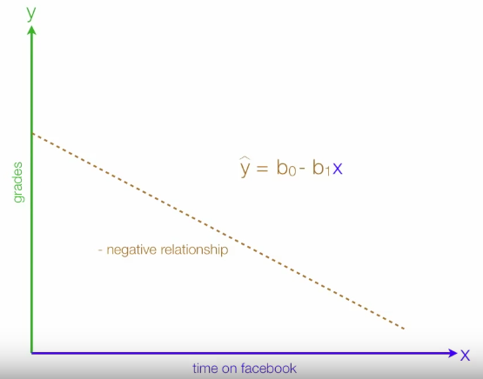
Negative Linear Relationship

Slide 18
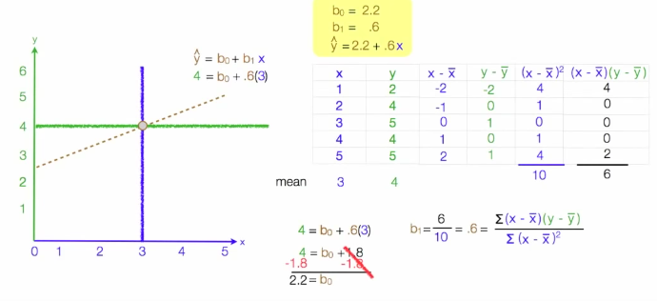
Simple Linear Regression
Notes:
Try to find a line that will fit all my points, based on the Least square method

Slide 19
Estimating Parameters: Least Squares Method
Notes:
40

Slide 20
Scatter plot
1. Plot of All (X_{i}, Y_{i}) Pairs
2. Suggests How Well Model Will Fit
Y
60
40
20
0
X
0
20
40
60

Slide 21
Thinking Challenge
How would you draw a line through the points? How do you determine which line ‘fits best’?
Y
60
40
20
0
X
0
20
40
60
Notes:
42

Slide 22
Thinking Challenge
How would you draw a line through the points? How do you determine which line ‘fits best’?
Slope changed
Y
60
40
20
0
X
0
20
40
60
Intercept unchanged
Notes:
43

Slide 23
Thinking Challenge
How would you draw a line through the points? How do you determine which line ‘fits best’?
Slope unchanged
Y
60
40
20
0
X
0
20
40
60
Intercept changed
Notes:
44

Slide 24
Thinking Challenge
How would you draw a line through the points? How do you determine which line ‘fits best’?
Slope changed
Y
60
40
20
0
X
0
20
40
60
Intercept changed
Notes:
45

Slide 25
Least Squares
1. ‘Best Fit’ Means Difference Between Actual Y Values & Predicted Y Values are a Minimum. But Positive Differences Off-Set Negative ones
Notes:
49

Slide 26
Least Squares
1. ‘Best Fit’ Means Difference Between Actual Y Values & Predicted Y Values are a Minimum. But Positive Differences Off-Set Negative ones. So square errors!
Notes:
50

Slide 27
Least Squares
1. ‘Best Fit’ Means Difference Between Actual Y Values & Predicted Y Values Are a Minimum. But Positive Differences Off-Set Negative. So square errors!
2. LS Minimizes the Sum of the Squared Differences (errors) (SSE)
Notes:
51

Slide 28
Least Squares Graphically
Notes:
52

Slide 29
Coefficient Equations
Prediction equation
Sample slope
Sample Y - intercept

Slide 30
Derivation of Parameters (1)
Least Squares (L-S):
Minimize squared error

Slide 31
Derivation of Parameters (1)
Least Squares (L-S):
Minimize squared error

Slide 32
Computation Table
Notes:
54

Slide 33
Interpretation of Coefficients

Slide 34
Interpretation of Coefficients
^
1. Slope (β₁)
Estimated Y Changes by β₁ for Each 1 Unit Increase in X
If β₁ = 2, then Y Is Expected to Increase by 2 for Each 1 Unit Increase in X
^
^

Slide 35
Interpretation of Coefficients
^
1. Slope (β₁)
Estimated Y Changes by β₁ for Each 1 Unit Increase in X
If β₁ = 2, then Y Is Expected to Increase by 2 for Each 1 Unit Increase in X
2. Y-Intercept (β₀)
Average Value of Y When X = 0
If β₀ = 4, then Average Y Is Expected to Be 4 When X Is 0
^
^
^
^

Slide 36

Parameter Estimation Example
Obstetrics: What is the relationship between Mother’s Estriol level & Birthweight using the following data?
Estriol Birthweight
(mg/24h) (g/1000)
1 1 2 1 3 2 4 2 5 4

Slide 37
Scatterplot Birthweight vs. Estriol level
Birthweight
Estriol level
Notes:
57

Slide 38
Parameter Estimation Solution Table
Notes:
58

Slide 39
Parameter Estimation Solution
Notes:
59

Slide 40
Coefficient Interpretation Solution

Slide 41
Coefficient Interpretation Solution
^
1. Slope (β₁)
Birthweight (Y) Is Expected to Increase by .7 Units for Each 1 unit Increase in Estriol (X)

Slide 42
Coefficient Interpretation Solution
^
1. Slope (β₁)
Birthweight (Y) Is Expected to Increase by .7 Units for Each 1 unit Increase in Estriol (X)
2. Intercept (β₀)
Average Birthweight (Y) Is -.10 Units When Estriol level (X) Is 0
Difficult to explain
The birthweight should always be positive
^

Slide 43
Simple Linear Regression
Notes:
Try to find a line that will fit all my points, based on the Least square method

Slide 44
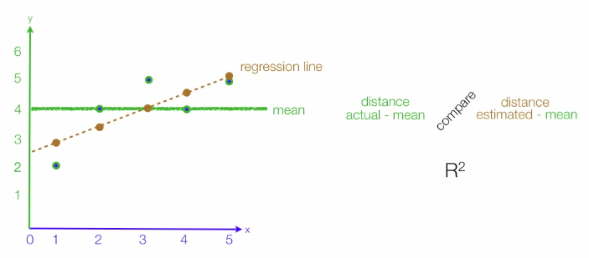

Slide 45
Simple Linear Regression
Example: Reed Auto Sales
Reed Auto periodically has a special week-long sale.
As part of the advertising campaign Reed runs one or
more television commercials during the weekend
preceding the sale. Data from a sample of 5 previous
sales are shown on the next slide.

Slide 46
Simple Linear Regression
Example: Reed Auto Sales
Number of
TV Ads (x)
Number of
Cars Sold (y)
1
3
2
1
3
14
24
18
17
27
Σx = 10
Σy = 100

Slide 47
Estimated Regression Equation
Slope for the Estimated Regression Equation
y-Intercept for the Estimated Regression Equation
Estimated Regression Equation

Slide 48
Coefficient of Determination
R² is a statistic that will give some information about the goodness of fit of a model. In regression, the R2 coefficient of determination is a statistical measure of how well the regression line approximates the real data points. An R2 of 1 indicates that the regression line perfectly fits the data.
Relationship Among SST, SSR, SSE
SST = SSR + SSE
where:
SST = total sum of squares
SSR = sum of squares due to regression
SSE = sum of squares due to error

Slide 49
Coefficient of Determination
The coefficient of determination is:
r² = SSR/SST
where:
SSR = sum of squares due to regression
SST = total sum of squares
r² gives information about the goodness of fit of a model.
In regression, the r² coefficient of determination is a statistical measure of how well the regression line approximates the real data points.
An r² of 1 indicates that the regression line perfectly fits the data.

Slide 50
Coefficient of Determination
r² = SSR/SST = 100/114 = .8772
The regression relationship is very strong; 87.72%
of the variability in the number of cars sold can be
explained by the linear relationship between the
number of TV ads and the number of cars sold.

Slide 51
Sample Correlation Coefficient
where:
b₁ = the slope of the estimated regression
equation

Slide 52
Sample Correlation Coefficient
The sign of b₁ in the equation is “+”.
r_{xy} = +.9366

Slide 53
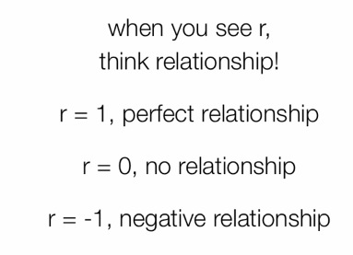
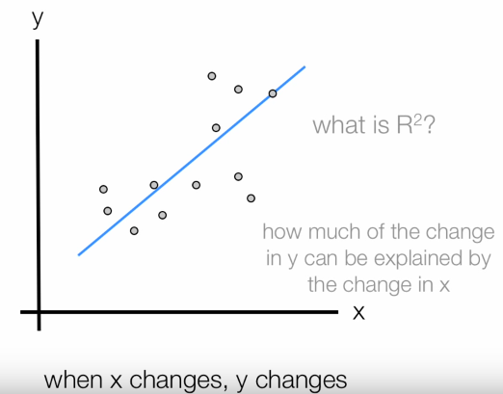

Slide 54
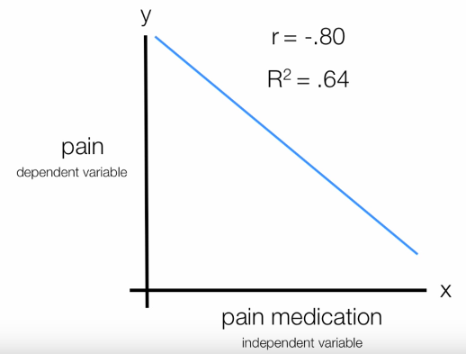
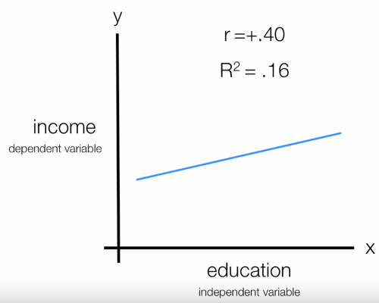
R2 shows the intensity or how strong is the relationship.

Slide 55
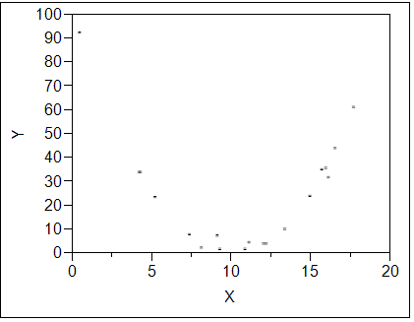
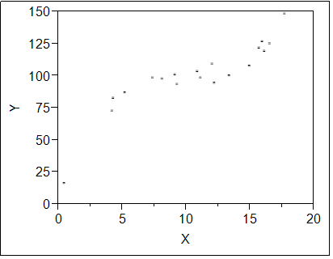
Types of Relationships Between Two Continuous Variables
Curved Relationship
No Relationship

Slide 56
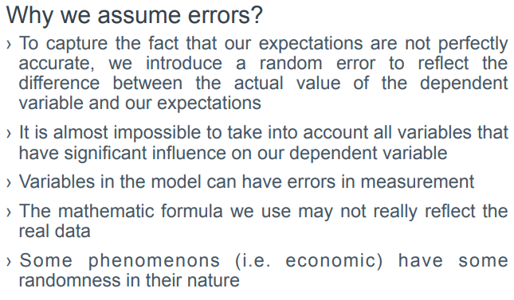

Slide 57
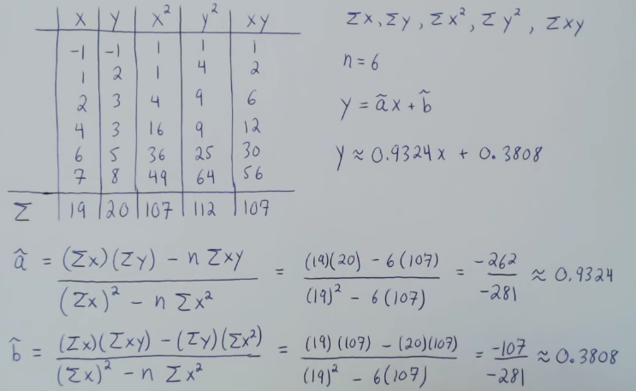

Slide 58
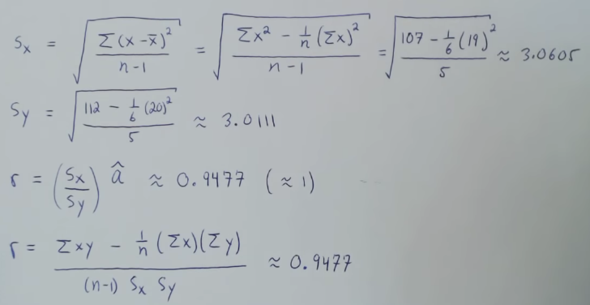

Slide 59
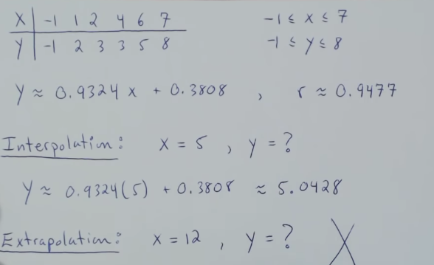

Slide 60
Pearson Product-Moment Correlation or Pearson correlation coefficient
The Pearson product-moment correlation coefficient is a measure of the strength of a linear association between two variables and is denoted by r.
A Pearson product-moment correlation attempts to draw a line of best fit through the data of two variables, and the Pearson correlation coefficient, r, indicates how far away all these data points are to this line of best fit
how well the data points fit this new model/line of best fit.

Slide 61
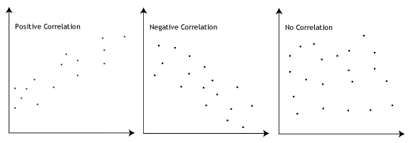
What values can the Pearson correlation coefficient take?
The Pearson correlation coefficient, r, can take a range of values from +1 to -1.
A value of 0 indicates that there is no association between the two variables.
A value greater than 0 indicates a positive association; that is, as the value of one variable increases, so does the value of the other variable.
A value less than 0 indicates a negative association; that is, as the value of one variable increases, the value of the other variable decreases.
This is shown in the diagram below:

Slide 62
How can we determine the strength of association based on the Pearson correlation coefficient?
The stronger the association of the two variables, the closer the Pearson correlation coefficient, r, to either +1 (relationship is positive) or -1 (relationship is negative).
Achieving a value of +1 or -1 means that all your data points are included on the line of best fit – there are no data points that show any variation away from this line.
Values for r between +1 and -1 (for example, r = 0.8 or -0.4) indicate that there is variation around the line of best fit.
The closer the value of r to 0 the greater the variation around the line of best fit.

Slide 63
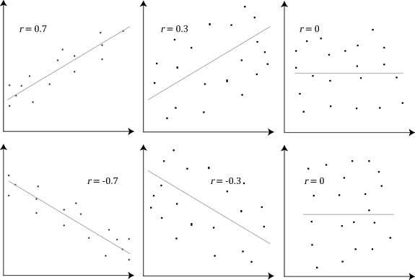

Slide 64
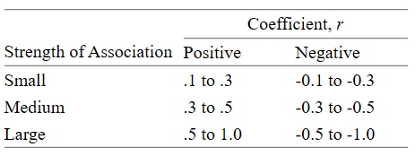
Are there guidelines to interpreting Pearson's correlation coefficient?
The following guidelines have been proposed:

Slide 65
Do the two variables have to be measured in the same units?
The two variables can be measured in entirely different units.
For example, you could correlate a person's age with their blood sugar levels.
Here, the units are completely different; age is measured in years and blood sugar level measured in mmol/L (a measure of concentration).

Slide 66
What about dependent and independent variables?
The Pearson product-moment correlation does not take into consideration whether a variable has been classified as a dependent or independent variable.
For example, you might want to find out whether basketball performance is correlated to a person's height.
You might, therefore, plot a graph of performance against height and calculate the Pearson correlation coefficient.
Lets say, for example, that r = .67. That is, as height increases so does basketball performance. This makes sense.
However, if we plot a graph of height against performance to determine whether a person's height was determined by their basketball performance (which makes no sense), we would still get r = .67.
This is because the Pearson correlation coefficient makes no account of any theory behind why you chose the two variables to compare.

Slide 67
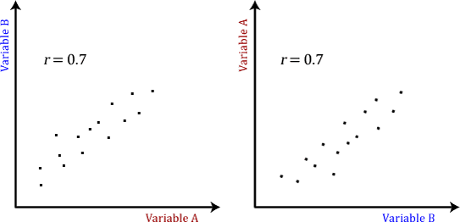
What about dependent and independent variables?

Slide 68
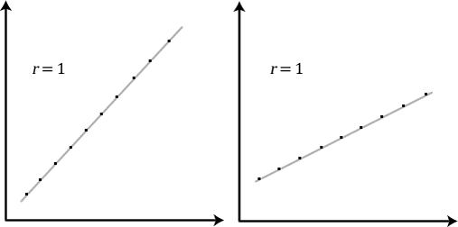
Does the Pearson correlation coefficient indicate the slope of the line?
Pearson correlation coefficient, r, does not represent the slope of the line of best fit.
Therefore, if you get a Pearson correlation coefficient of +1 this does not mean that for every unit increase in one variable there is a unit increase in another.
It simply means that there is no variation between the data points and the line of best fit.
Pearson's correlation determines the degree to which a relationship is linear.

Slide 69
What assumptions does Pearson's correlation make?
There are five assumptions that are made with respect to Pearson's correlation:
The variables must be either interval or ratio measurements (difference between 20°C and 30°C is the same as 30°C to 40°C is an interval variable, where as a distance of 10 metres is twice the distance of 5 metres is ratio variable)
The variables must be approximately normally distributed
There is a linear relationship between the two variables
Outliers are either kept to a minimum or are removed entirely.
There is homoscedasticity of the data.

Slide 70
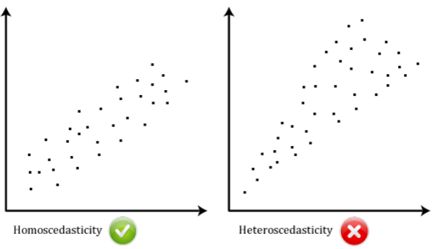
What is homoscedasticity?
Homoscedasticity basically means that the variances along the line of best fit remain similar as you move along the line.
It is required that your data show homoscedasticity for you to run a Pearson product-moment correlation.
Homoscedasticity is most easily demonstrated diagrammatically as below:

Slide 71
Pearson’s correlation: Real Life Example
Scientists in China wanted to know if there was a relationship between how weedy rice populations are different genetically.
The goal was to find out the evolutionary potential of the rice.
Pearson’s correlation between the two groups was analyzed.
It showed a positive Pearson Product Moment correlation of between 0.783 and 0.895 for weedy rice populations.
This figure is quite high, which suggested a fairly strong relationship.

Slide 72
Pearson’s correlation: Real Life Example
Sample question: Find the value of the correlation coefficient from the following table:
Subject | Age x | Glucose Level y
1 | 43 | 99
2 | 21 | 65
3 | 25 | 79
4 | 42 | 75
5 | 57 | 87
6 | 59 | 81

Slide 73
Pearson’s correlation: Real Life Example
Use the given data, and add three more columns: xy, x², and y².
Multiply x and y together to fill the xy column.
Take the square of the numbers in the x column, and put the result in the x² column.
Take the square of the numbers in the y column, and put the result in the y² column.
Add up all of the numbers in the columns and put the result at the bottom of the column.

Slide 74
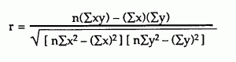
Pearson’s correlation: Real Life Example
Subject | Age x | Glucose Level y | xy | x² | y²
1 | 43 | 99 | 4257 | 1849 | 9801
2 | 21 | 65 | 1365 | 441 | 4225
3 | 25 | 79 | 1975 | 625 | 6241
4 | 42 | 75 | 3150 | 1764 | 5625
5 | 57 | 87 | 4959 | 3249 | 7569
6 | 59 | 81 | 4779 | 3481 | 6561
Σ | 247 | 486 | 20485 | 11409 | 40022
Use the following correlation coefficient formula.
The answer is: 2868 / 5413.27 = 0.529809
= 6(20,485) – (247 × 486) /
[√[[6(11,409) – (2472)] × [6(40,022) – 4862]]]
which means the variables have a moderate positive correlation.

Slide 75
Spearman's rank-order correlation

Slide 76
When should you use the Spearman's rank-order correlation?
The Spearman's rank-order correlation is the nonparametric version of the Pearson product-moment correlation.
Spearman's correlation coefficient, (ρ, also signified by rs) measures the strength and direction of association between two ranked variables.

Slide 77
What are the assumptions of the test?
You need two variables that are either ordinal, interval or ratio.
Spearman's correlation determines the strength and direction of the monotonic relationship between the two variables

Slide 78
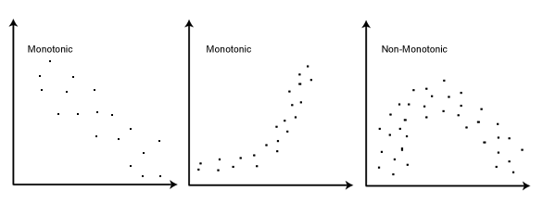
What is a monotonic relationship?
A monotonic relationship is a relationship that does one of the following: (1) as the value of one variable increases, so does the value of the other variable; or (2) as the value of one variable increases, the other variable value decreases.
Monotonicity is "less restrictive" than that of a linear relationship.
For example, the middle image above shows a relationship that is monotonic, but not linear.

Slide 79
Why is a monotonic relationship important to Spearman's correlation?
A monotonic relationship is not strictly an assumption of Spearman's correlation.
You can run a Spearman's correlation on a non-monotonic relationship to determine if there is a monotonic component to the association.
If a scatterplot shows that the relationship between your two variables looks monotonic you would run a Spearman's correlation because this will then measure the strength and direction of this monotonic relationship.
On the other hand if, for example, the relationship appears linear (assessed via scatterplot) you would run a Pearson's correlation because this will measure the strength and direction of any linear relationship.

Slide 80
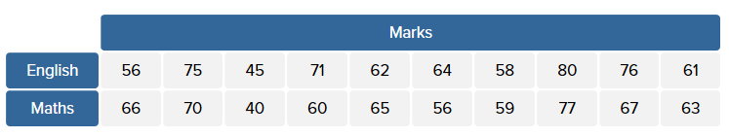
Spearman's Rank-Order Correlation
An example of calculating Spearman's correlation
To calculate a Spearman rank-order correlation on data without any ties we will use the following data:

Slide 81
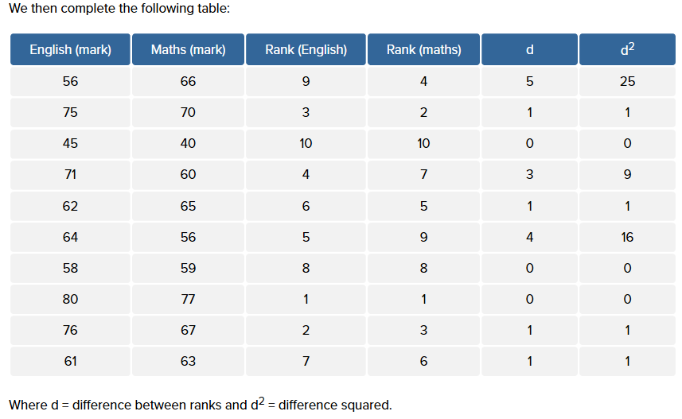

Slide 82
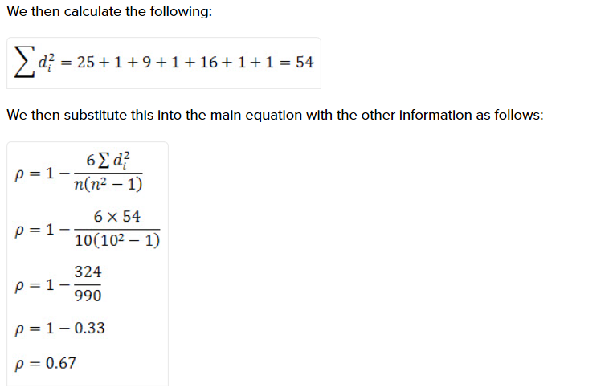
where n = 10.
We have calculated a ρ (or r_{s}) of 0.67.
This indicates a strong positive relationship between the ranks individuals obtained in the maths and English exam.
That is, the higher you ranked in maths, the higher you ranked in English also, and vice versa.

Slide 83

Spearman's Rank-Order Correlation
The formula to use when there are tied ranks is:
Spearman Formula
where i = paired score.

Slide 84


How do you report a Spearman's correlation?
If you have simply run the Spearman correlation without any statistical significance tests, you are able to simple state the value of the coefficient as shown below:
However, if you have also run statistical significance tests, you need to include some more information as shown below:
where df = N – 2, where N = number of pairwise cases.

Slide 85
How do you express the null hypothesis for this test?
The general form of a null hypothesis for a Spearman correlation is:
H₀: There is no [monotonic] association between the two variables [in the population].
A null hypothesis statement for the example used earlier in this guide would be:
H₀: There is no [monotonic] association between maths and English marks.

Slide 86
How do I interpret a statistically significant Spearman correlation?
The statistical significance testing of the Spearman correlation does not provide you with any information about the strength of the relationship.
Achieving a value of p = 0.001, for example, does not mean that the relationship is stronger than if you achieved a value of p = 0.04.
This is because the significance test is investigating whether you can reject or fail to reject the null hypothesis.
If you set α = 0.05, achieving a statistically significant Spearman rank-order correlation means that you can be sure that there is less than a 5% chance that the strength of the relationship you found (your ρ coefficient) happened by chance if the null hypothesis were true.

Slide 87
Kendall’s Tau?
Kendall’s Tau is a non-parametric measure of relationships between columns of ranked data. The Tau correlation coefficient returns a value of 0 to 1, where:
0 is no relationship,
1 is a perfect relationship.
Kendall's rank correlation provides a distribution free test of independence and a measure of the strength of dependence between two variables.
Spearman's rank correlation is satisfactory for testing a null hypothesis of independence between two variables but it is difficult to interpret when the null hypothesis is rejected.
Kendall's rank correlation improves upon this by reflecting the strength of the dependence between the variables being compared.

Slide 88
Kendall’s Tau?
For example, you could use Kendall's tau-b to understand whether there is an association between exam grades (A, B, C, D, E and F) and time spent revising (less than 5 hours, 5-9 hours, 10-14 hours, 15-19 hours, and 20 hours or more).
Alternately, you could use Kendall's tau-b to understand whether there is an association between customer satisfaction (i.e., where the level of agreement had five categories: strongly agree, agree, neither agree nor disagree, disagree and strongly disagree) and delivery time (i.e., where delivery time had four categories – next day, 2 working days, 3-5 working days, and more than 5 working days)

Slide 89
Assumptions in the Kendall’s Tau
Assumption #1: Your two variables should be measured on an ordinal or continuous scale.
Examples of ordinal variables include Likert scales (e.g., a 7-point scale from strongly agree through to strongly disagree), amongst other ways of ranking categories (e.g., a 5-point scale explaining how much a customer liked a product, ranging from "Not very much" to "Yes, a lot").
Examples of continuous variables (i.e., interval or ratio variables) include revision time (measured in hours), intelligence (measured using IQ score), exam performance (measured from 0 to 100), weight (measured in kg), and so forth.
Assumption #2: Kendall's tau-b determines whether there is a monotonic relationship between your two variables.

Slide 90
Kendall’s Tau
Most statistical packages have Tau-B built in, but you can use the following formula to calculate it by hand:
Kendall’s Tau = (C – D / C + D)

Slide 91
Example Problem on Kendall’s Tau
Sample Question: Two interviewers ranked 12 candidates (A through L) for a position. The results from most preferred to least preferred are:
Interviewer 1: ABCDEFGHIJKL.
Interviewer 2: ABDCFEHGJILK.
Calculate the Kendall Tau correlation.

Slide 92
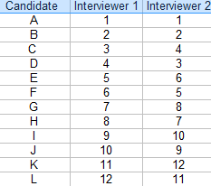
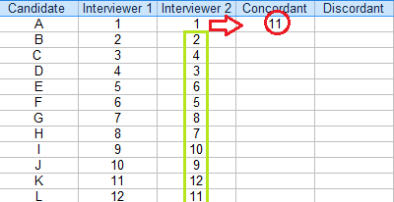
Kendall’s Tau
Count the number of concordant pairs:
Using the second column. Concordant pairs are how many larger ranks are below a certain rank. For example, the first rank in the second interviewer’s column is a “1”, so all 11 ranks below it are larger.
Make a table of rankings.

Slide 93
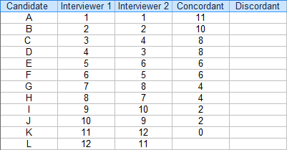
Kendall’s Tau
When all concordant pairs have been counted, it looks like this:

Slide 94
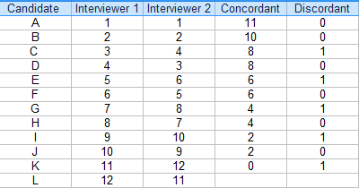
Kendall’s Tau
Count the number of discordant pairs and insert them into the next column. The number of discordant pairs is similar to Step 2, only you’re looking for smaller ranks, not larger ones.

Slide 95
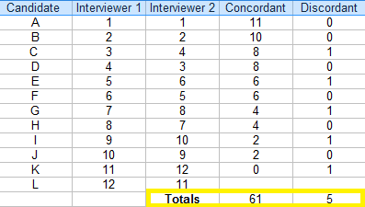
Kendall’s Tau
Sum the values in the two columns:
Insert the totals into the formula:
Kendall’s Tau = (C – D / C + D)
= (61 – 5) / (61 + 5) = 56 / 66 = .85.
The Tau coefficient is .85, suggesting a strong relationship between the rankings.

Slide 96


Kendall’s Tau
If you want to calculate statistical significance for your result, use this formula to get a z-value:
Inserting the values from our results:
= 3 * .85 * 11.489 / 7.616
= 3.85.
Finding the area for a z-score of 3.85 on a z-table gives an area of .0001 — a tiny probability value which tells you this result is statistically significant.

